Slide 1
DISC Leadership
Abby May
September 12, 2012

Slide 2
What are the reasons why leaders are unsuccessful?
#1 Reason…… Failure of leaders to analyze and work with others. This makes managing groups, creating change, setting goals and effectively coaching a team - unsuccessful.

Slide 3
What does your favorite color say about you???
Pick your favorite color …..
How do you differ from others?

Slide 4
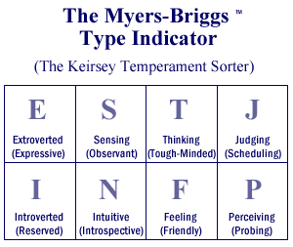
#1 Personality: Myers-Briggs Analysis
Practical Application – Step #1
Identify your own personality/leadership preferences.
Go to the website: http://similarminds.com/
Your type is: ESTJ
ESTJ - "Administrator". Much in touch with the external environment. Very responsible. Pillar of strength. 8.7% of total population.

Slide 5
#2 Leadership: DISCovering Yourself & Others
Then… Identify your natural leadership style.
Great Human Resources tool
Used in big business, Fortune 500 companies, and many sales forces
Easy 4 part descriptions whose characteristics are easy to identify!
So… what are you???
Complete survey and analysis……

Slide 6
#2 Leadership: DISCovering Yourself & Others
Then… Identify your natural leadership style.
SURVEYS:
http://www.123test.com/disc-personality-test/
http://www.quibblo.com/quiz/aw8npyx/DISC-Personality-Style?view_quiz=1

Slide 7
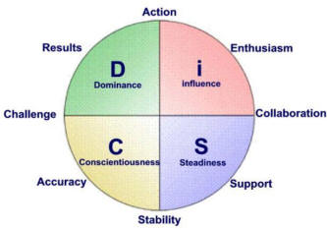
The Breakdown…………

Slide 8
Lets think about what these letters say about you?
How are you energized?
What information grabs your attention?
How do you make decisions?
How do you approach life and work?

Slide 9
Practical Application – Step #3
Practical Application – Step #2
Identify your teams’ personalities.
Consider differences between your own preferences and those that you are working with.

Slide 10
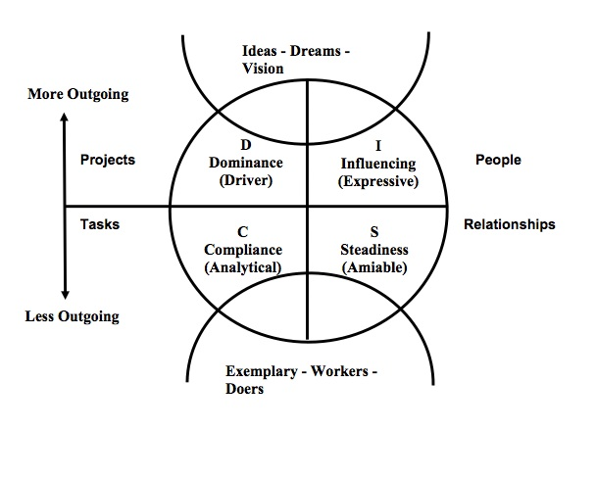
How does this apply to working with others…

Slide 11
Practical Application – Step #5
Practical Application – Step #4
Determine which strategies best fit others’ preferences.
Identify strategies for working together.

Slide 12
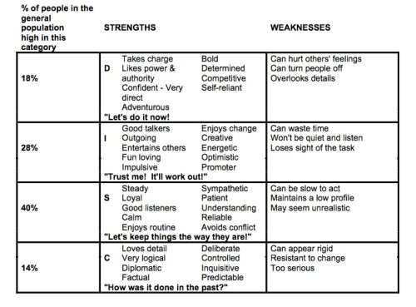
How it helps in leading…..
Use DISC Handouts to uncover more about the 4 personality types!

Slide 13
Case Studies - DISC
How would you get a “C” to change?
How would you help lead a “D”?
How can you provide growth for an “S”?
How do you help a struggling “I”?

